Slide 1


Recipe Sharing Platform: Connecting Food Lovers
Welcome! This presentation delves into the development of our recipe sharing platform, a project fueled by a passion for connecting food lovers and fostering a community centered around culinary creativity.

Slide 2

Our Team: A Culinary Collective
Name
Role
Mohamed Dawoud
Full Stack Developer

Slide 3

Inspiration: Sharing Culinary Joy
The inspiration for this project stemmed from our shared love for food and a desire to create a platform where people could share their culinary creations and connect with fellow food enthusiasts. We envisioned a space where users could discover new recipes, be inspired by others' creations, and contribute their own culinary expertise. Our goal was to foster a sense of community and create a platform that celebrates the joy of cooking and sharing food.

Slide 4
Technology & Architecture: Building the Platform
Front-End: User Experience
Back-End: Powering the Platform
Database: Storing the Culinary Heart
We built the front-end with HTML, CSS, and JavaScript, creating an intuitive and engaging interface for users to explore recipes, manage their profiles, and interact with the platform. We focused on user-friendliness, responsiveness, and a visually appealing design to enhance the user experience.
The back-end, powered by Node.js, handles server-side logic, user authentication, and API integration. We implemented robust security measures to protect user data and ensure a secure environment. The back-end also handles recipe data processing, search functionalities, and data storage in the MySQL database.
We chose MySQL as our database management system to store user information, recipe data, and other relevant entities. MySQL provides a reliable and efficient platform for managing large volumes of data, ensuring data integrity and scalability.

Slide 5

Core Algorithms: Recipe Search and Filtering
We implemented a robust recipe search algorithm that leverages natural language processing techniques to understand user queries. The algorithm considers keywords, ingredient names, cooking methods, and dietary restrictions to provide relevant search results. Additionally, we developed a filtering system that allows users to narrow down their search results by categories, cuisines, dietary restrictions, and other criteria.
const searchRecipes = (query) => { // ... NLP processing, keyword extraction, filtering return filteredRecipes; };

Slide 6
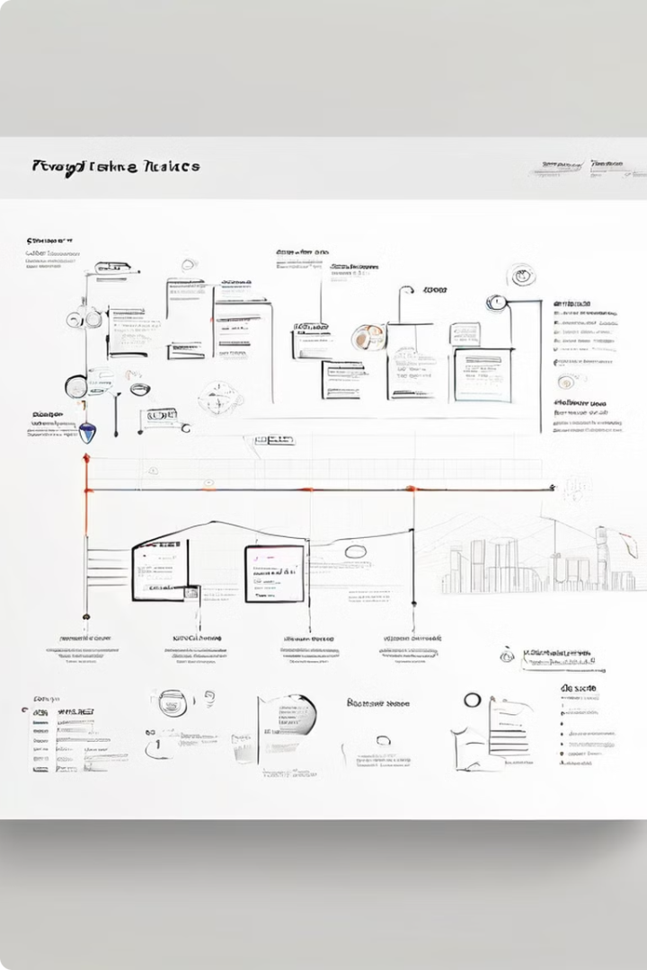
Process, Collaboration, & Timeline: A Collective Effort
1
Planning & Design
The initial phase involved defining the project scope, gathering user requirements, and designing the platform's architecture and user interface. This stage involved extensive brainstorming, wireframing, and prototyping to ensure a user-centered approach.
2
Development & Testing
We implemented the front-end, back-end, and database components in an iterative manner, conducting thorough testing at each stage. We used version control tools and a collaborative workflow to ensure smooth integration and effective communication among team members.
3
Deployment & Refinement
Once development was complete, we deployed the platform on a secure server and conducted extensive testing and user feedback to refine functionalities and ensure optimal performance. We implemented a continuous integration and continuous delivery (CI/CD) pipeline to facilitate ongoing updates and improvements.

Slide 7

Challenges Overcome: Mastering the Culinary Code
1
Data Management
2
User Authentication & Security
Efficiently managing and querying a large database of recipes was a significant challenge. We addressed this by implementing a relational database schema that optimizes data storage, retrieval, and search functionalities.
Implementing secure user authentication and protecting sensitive user data was a priority. We employed industry-standard encryption techniques and followed best practices for data security to ensure a safe and reliable platform.
3
API Integration & Performance Optimization
4
User Interface Design & User Experience
Integrating external APIs for recipe search and other functionalities required careful planning and efficient code implementation. We focused on optimizing API calls, caching data, and minimizing latency to enhance platform performance.
Creating a visually appealing and user-friendly interface was essential for user engagement. We conducted extensive user testing and incorporated feedback to enhance usability, navigation, and overall user experience.

Slide 8

Learnings: Fueling Future Culinary Creations
This project provided valuable insights into the intricacies of web development, database management, and API integration. We gained hands-on experience with various technologies, honed our problem-solving skills, and deepened our understanding of software development methodologies. This project has fueled our passion for building innovative and user-centric applications, and we are eager to apply these learnings to future projects that contribute to a better world.

